Slide 1
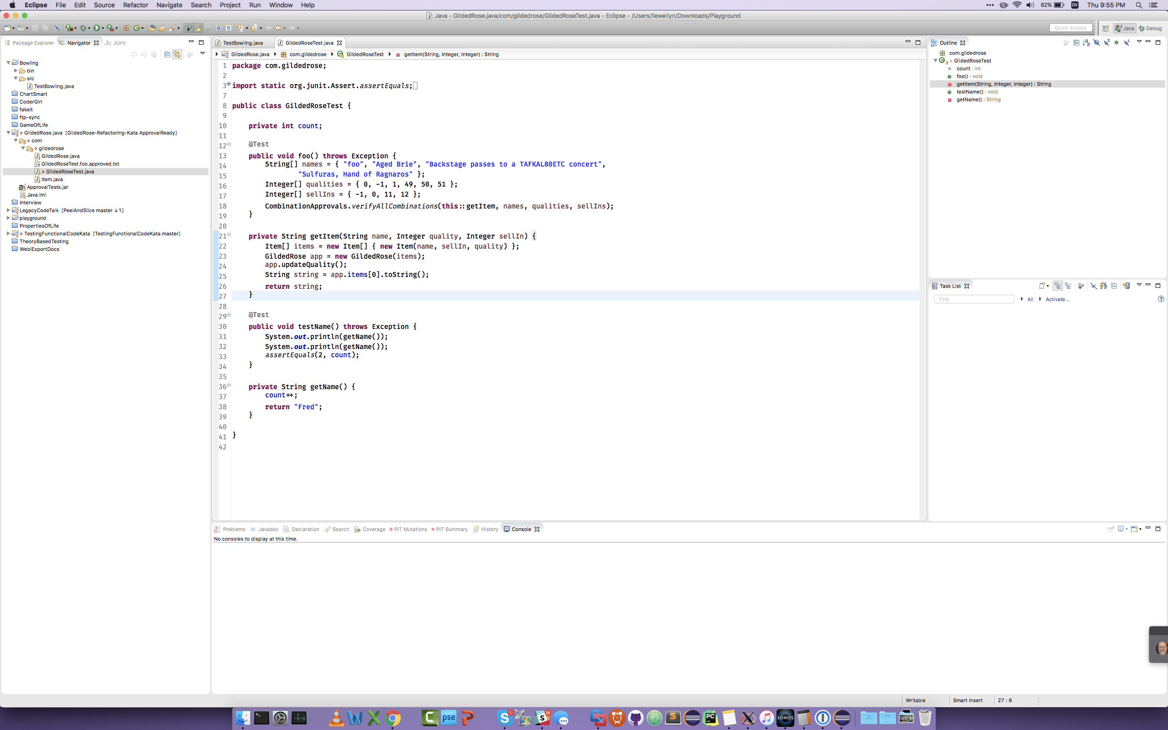
2
1
3
4
5
8
9
6
7
Numbers go
(top-> bottom, left -> right)
1. Menu bar > Navigate
2. Windows Buttons > Maximize
3. Tool Bar > Run Button
4. Tool Bar > Back Button > Drop Down Menu
5. Tool Bar > Left Side > Quick Access
6. Left Tabwell > Window Buttons
7. Main Window > 2nd Tab
8. Right Tabwell > Toolbar > minimize all
9. Left Tabwell > Toolbar > minimize all
10. Outline Tab > Right Tabwell
11. Main Window > Gutter
12. Line 26.5
13. Navigator Tab > Left Tabwell
14. Main Window
15. History Tab > Bottom Tabwell
16. Console Tab > Bottom Tabwell > Toolbar > Pin Console
17. Console Tabwell > Bottom Tabwell
18. Dock > Skype
10
11
12
13
14
15
16
17
Made by:
LlewellynFalco
This is a work in progress, please send suggestions via twitter
18

